Slide 1
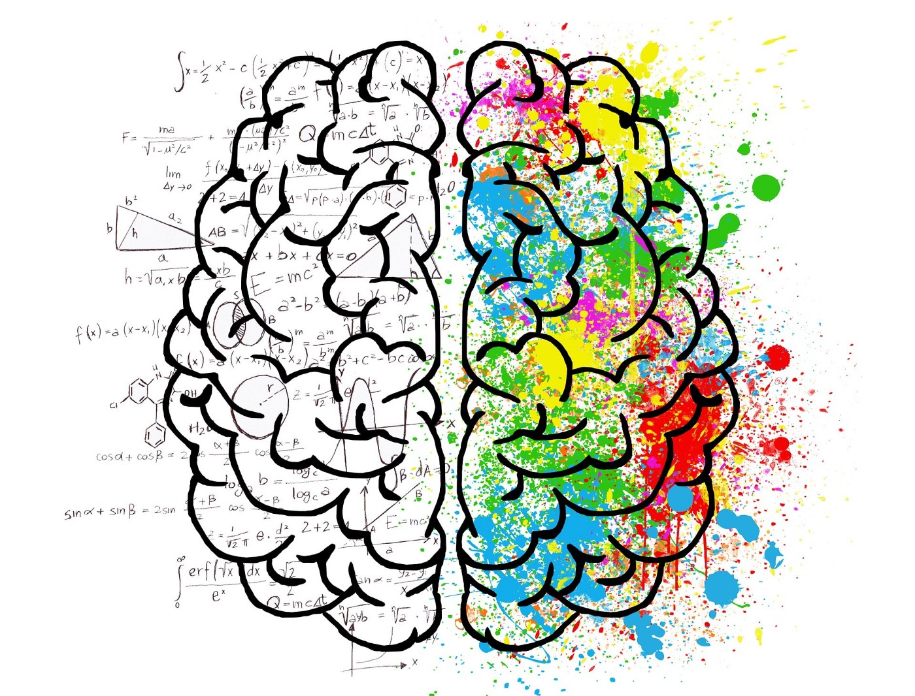
NLP from a technical view to a business use case
kmerai-2022

Slide 2


Isaac Yimgaing K.
France
+4 in AI, ML and NLP
(0033) 769 88 63 25
Medias:
medium.com/@isaackuissu
isaac.yimgaing@gmail.com
researchgate.net/publication/352191417
in/isaac-yimgaing

Slide 3
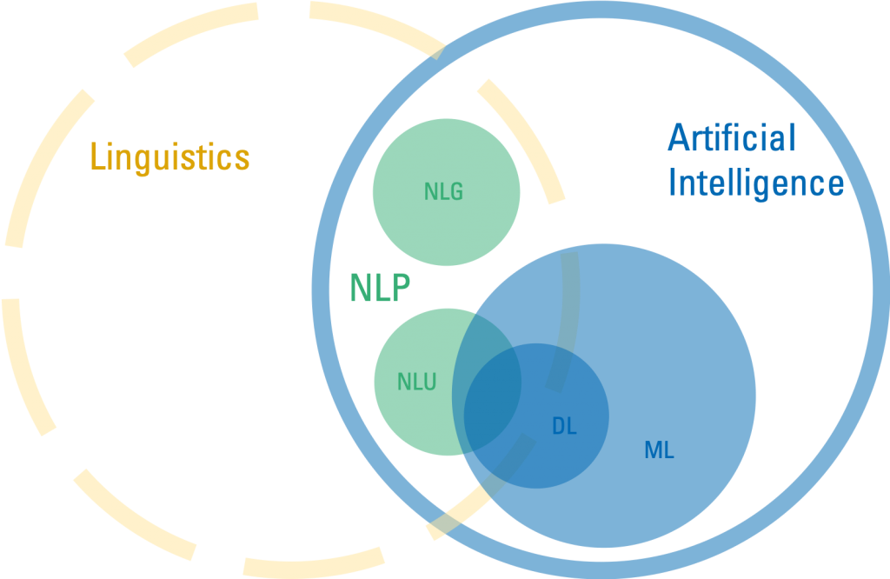
What is NLP

Slide 4
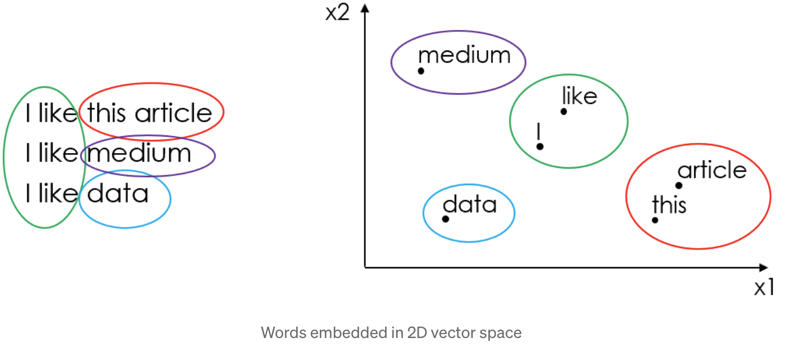
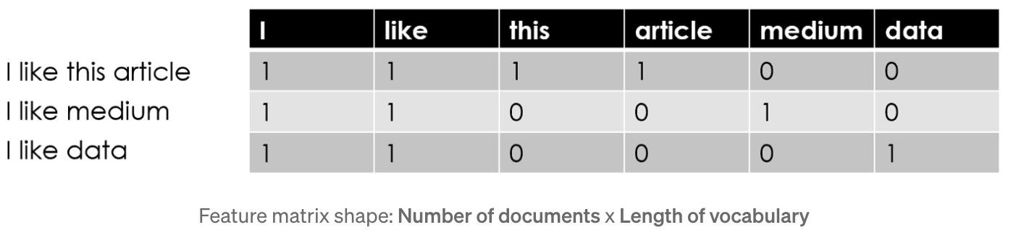
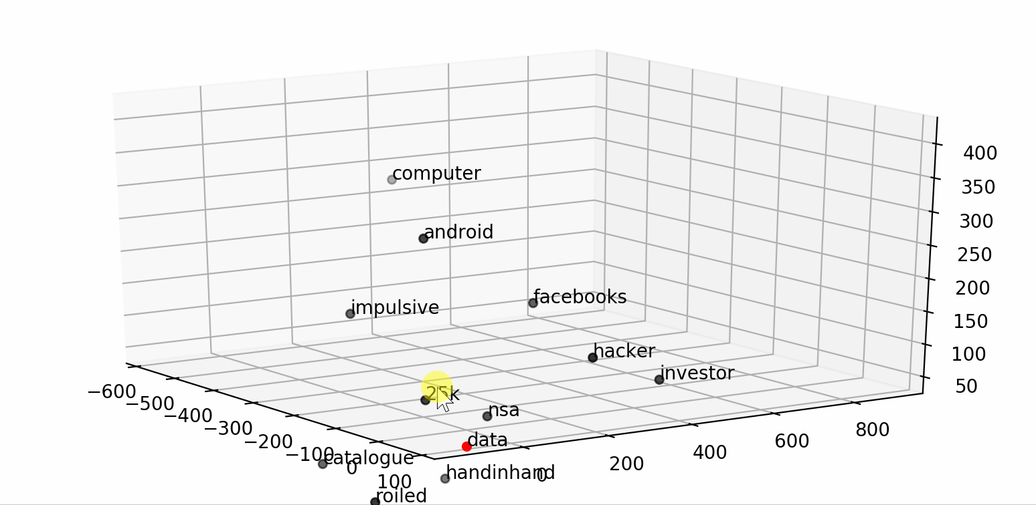
NLP: How it works

Slide 5
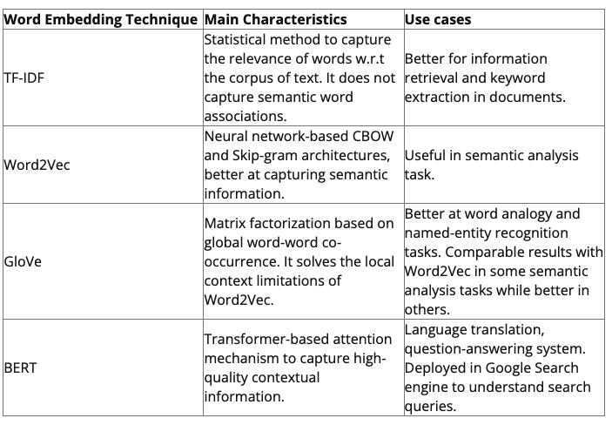
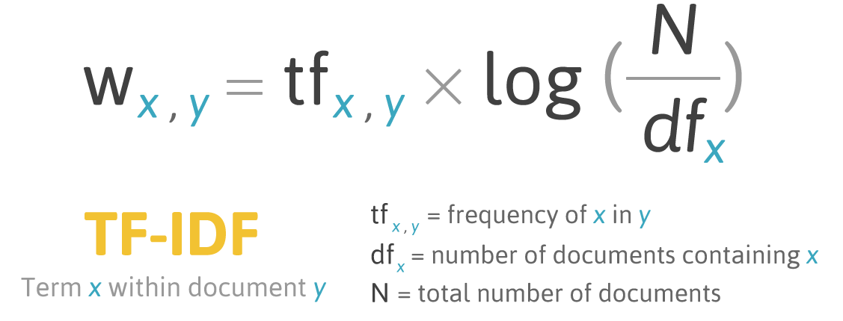
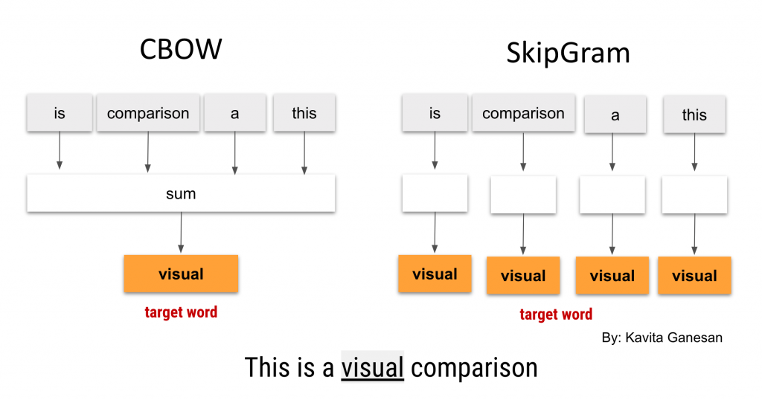
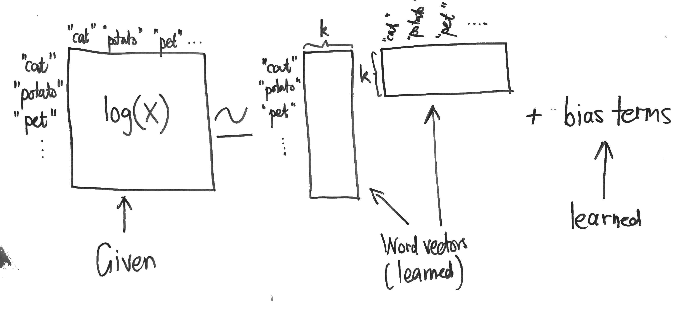
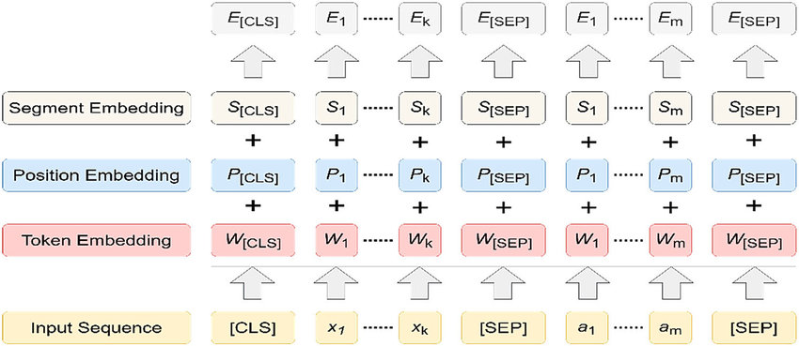
NLP: Embedding
Galaxies Visualization

Slide 6
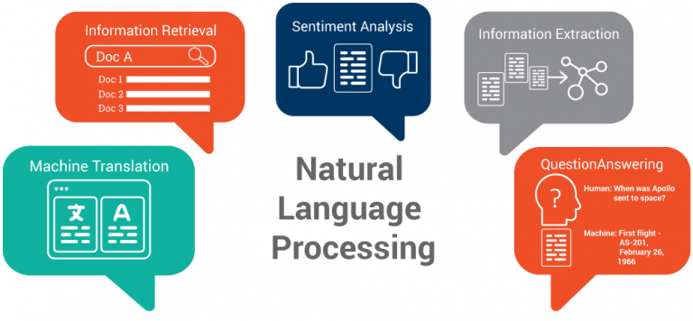
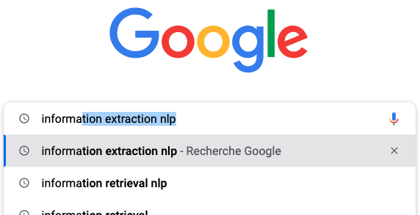
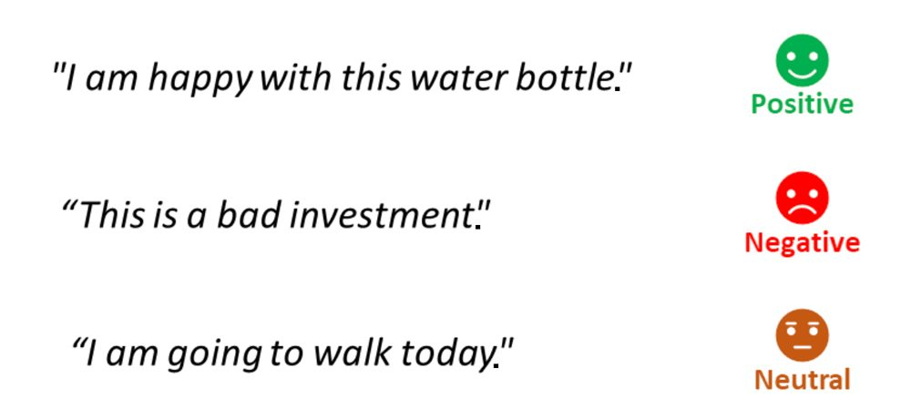
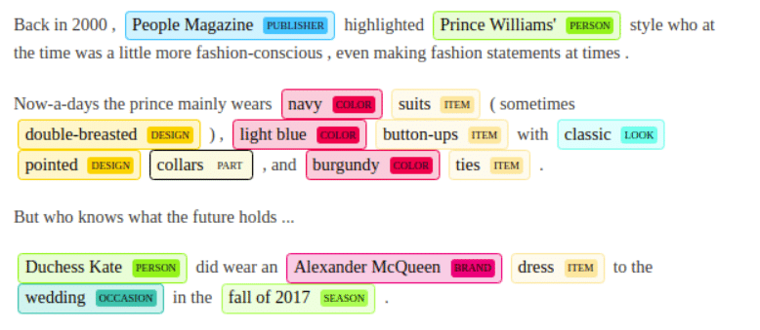

NLP: use cases
And much more…

Slide 7
DEMO

Slide 8

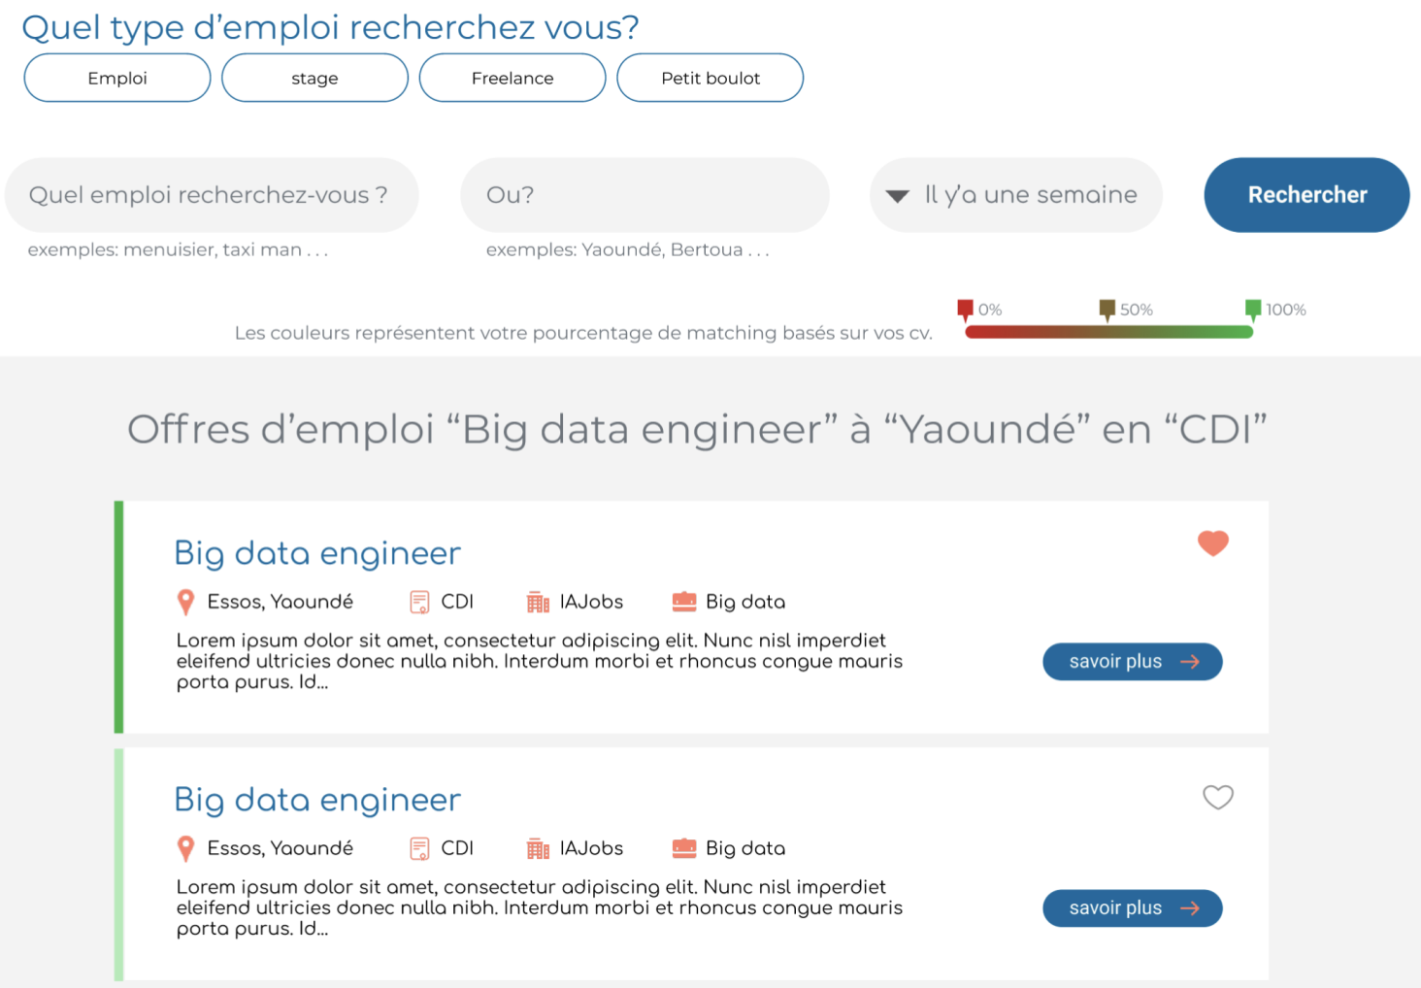
Problem
To help people easily find the job that fits their needs.
Use ML and AI to rank jobs and extract key information.
Solution
Our Process
Sql
DB match
NER
data
computer
Classification
Data engineer
Search engine

Slide 9
NLP: How to start?
1. https://github.com/gutfeeling/beginner_nlp
2. https://www.udemy.com/topic/natural-language-processing/
3. https://github.com/shashankg7/Deep-Learning-for-NLP-Resources
4. https://github.com/datascienceid/nlp-resources
5. https://github.com/keon/awesome-nlp
6. https://dataaspirant.com/word-embedding-techniques-nlp/
7. https://medium.com/@hari4om/word-embedding-d816f643140

Slide 10

Thanks!
Do you have any questions?
isaac.yimgaing@gmail.com
Please keep this slide for attribution

